Slide 1
Chapter 1: Introduction to Systems Analysis and Design

Slide 2
Learning Objectives
Systems development life cycle
Identify the four phases
How it came about
Methodology alternatives
Team roles & skill sets
Object-oriented systems characteristics
Object-oriented systems analysis & design
The Unified Process & its extensions
The Unified Modeling Language (UML)

Slide 3
Introduction
Why do we need a formal process?
Failures occur (too) often
Creating systems is not intuitive
Projects are late, over budget or delivered with fewer features than planned
The System Analyst is the key person
Designs a system to add value
Must understand the business processes
Job is rewarding, yet challenging
Requires specific skill sets
Notes:
분석가의 일은 보람은 있으나, challenging한다.

Slide 4
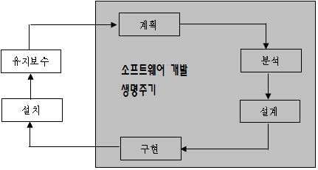
시스템 개발 과정

Slide 5
Systems Development Life Cycle (SDLC)
Planning
Analysis
Design
Implementation
Notes:
털자 -> 털기위해 분석 -> 털기위한 철저한 계획 -> 털기 수행

Slide 6
The SDLC Process
The process consists of four phases
Each phase consists of a series of steps
Each phase is documented (deliverables)
Phases are executed sequentially, incrementally, iteratively or in some other pattern
Notes:
각 단계는 스텝으로 이루어진고 순차적으로, 점진적으로, 반복해서 또는 어떠한 패턴에 따라 수행

Slide 7
Questions to be Answered
Planning phase
Why should we build this system?
What value does it provide?
How long will it take to build?
Analysis phase
Who will use it?
What should the system do for us?
Where & when will it be used?
Design phase
How should we build it?
Notes:
계획 : 복수를 위해, 한달만 고생하자, 보상이 있다(빈민구제 등).
분석 : 누가 사용하는가, 어떠한 기능을 해야하는가, 어디서 언제 사용하는가

Slide 8
SDLC: The Planning Phase
Project Initiation
Develop/receive a system request
Conduct a feasibility analysis
Project Management
Develop the work plan
Staff the project
Monitor & control the project

Slide 9
SDLC: The Analysis Phase
Develop an analysis strategy
Model the current system
Formulate the new system
Gather the requirements
Develop a system concept
Create a business model to represent:
Business data
Business processes
Develop a system proposal

Slide 10
SDLC: The Design Phase
Develop a design strategy
Design architecture and interfaces
Develop databases and file specifications
Develop the program design to specify:
What programs to write
What each program will do

Slide 11
SDLC: The Implementation Phase
Construct the system
Build it (write the programming code)
Test it
Install system
Train the users
Support the system (maintenance)

Slide 12
SDLC: Methodologies
Methodology: a formalized approach to implementing the SDLC
Categories
Process oriented
Data centered
Object-oriented
Structured
Rapid action development
Agile development

Slide 13
개발방법론
 | Process oriented 구조적 방법론 | Data oriented 정보공학 방법론 | Object Oriented 객체지향 방법론
계획 단계 | 타당성 분석 | 정보 전략 분석 | 프로젝트 문제 분석과 사용사례 분석
분석 단계 | 구조적 분석 | 비즈니스 영역 분석 | 요구 분석 및 모델링
설계 단계 | 구조적 설계 | 비즈니스 시스템 설계 | 시스템 설계와 객체 설계
구현 단계 | 구조적 프로그래밍 | 구축 전환 | 객체지향 프로그래밍
사용 단계 | 유지보수 | 생산 | 재사용, 유지보수

Slide 14
Classes of Methodologies
Structured Development
Waterfall Development
Parallel Development
Rapid Application Development
Phased
Prototyping
Agile Development
eXtreme Programming
SCRUM

Slide 15
소프트웨어 개발 프로세스 모델
생명 주기
소프트웨어 개발의 성패에 영향을 미치는 중요한 요소
소프트웨어를 개발해 나가는 단계나 과정
컨셉트를 정하는 것부터 소멸될 때까지
몇 달 또는 몇 년이 걸릴 수 있음
각 단계의 목표
명확한 작업 단계 / 손에 잡히는 결과 / 작업의 검토 / 다음 단계의 명시
Code-and-Fix
생명 주기가 없음

Slide 16
Classes of Methodologies
Structured Development
Waterfall Development
개발전 완전한 설계필요/분석과 개발 사이(몇개월 ~ 몇 년)
가끔 significant Rework 필요
차개발을 종이위 명시할 때 차개발-문열면 몇 개의 실내등을 켤까? 명시하기와 차에 몇 개의 실내등이 있는지 명시하기 힘들다.

Slide 17
Classes of Methodologies
Structured Development
Waterfall Development
Parallel Development – 분석과 시스템 납품사이 기간 최소화 목적 – rework 필요성 감소시킴
Subproject 사이 의존성 존재/설계결정이 서로 영향/require significant integration efforts필요

Slide 18
Classes of Methodologies
Structured Development
Waterfall Development
Parallel Development
Rapid Application Development-case, jad, 4gl, visual language, code generator 등 사용
문제점 : 사용자 기대치 높임,요구증가시킴, 문서철저 프로젝트의 경우 많은 시가 허비시킴
Phased-version1, version 2… 개발
사용자가 불완전한 시스템 사용시작함 – 단점
초기에 중요하고 필요한 feature 제공해야함.
Prototyping

Slide 19
A phased development-based mothodology

Slide 20
Classes of Methodologies
Structured Development
Rapid Application Development
Phased
Prototyping – 분석, 설계, 구현 동시진행
Spiral
초기 주요 문제점 및 이슈 등을 주의 깊고 체계적으로 분석하지 않고 도전 정신으로 극복 / 주요 결정사항 미스가 있을 수 있다. 차를 인수하여 1년 몰다가 엔진오일을 갈려고 하니 차를 다 분해해야함.
Throwaway

Slide 21
A prototyping based methodology

Slide 22
Classes of Methodologies
Structured Development
Rapid Application Development
Phased
Prototyping
Throwaway –prototyping
– 프로토타입을 주요 결정 사항에 사용
결과를 설계에 반영

Slide 24
Classes of Methodologies
Agile Development
eXtreme Programming
SCRUM

Slide 25
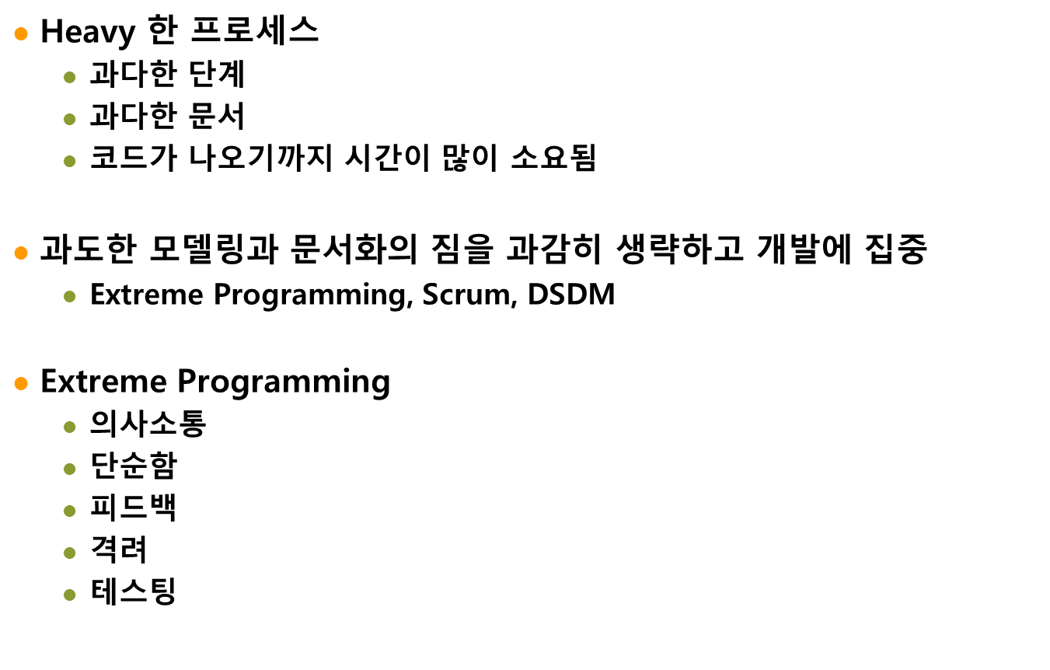
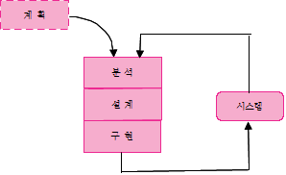
애자일 모형

Slide 26
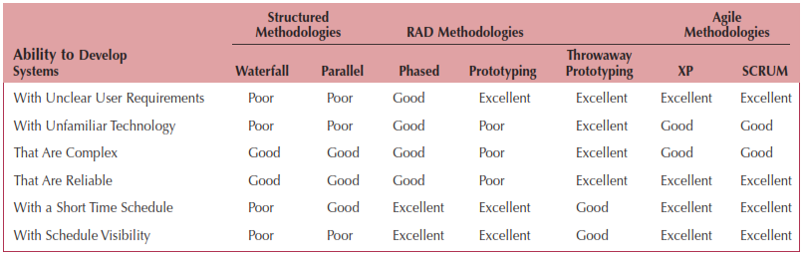
Which Methodology to Use?
Notes:
Waterfall : 자동차 만든 후 실내등이 않켜지면
Parallel development : general design -> 여러 개의 design 구현
-→ 한 곳에서의 설계 결정이 다른 곳에 영향을 준다. 프로젝트 끝에서 integratio이 무지 힘들다.
Rad (프로토 타입 제공) – managing user expection
Rad1 phased development : 차수를 나누어 개발을 진행(시스템 버전1, 1.1, 1.2, …. 2.0, ….)
사용자가 미완성된 시스템을 이용 업무를 진행한다. 따라서 가장 중용한 기능을 먼저 구현해야 한다.
Rad2 prototyping : - 가장 기본 적인 문제가 나중에 발견될 수 있다. – 자동차를 만들고 10,000km뛰고 난 후 엔진오일을 갈려고 했더니 엔진 전체를 들어내어야 한다.
Rad 3 throwaway – 분석과 설계단계가 끝날 때 까지 설계 프로토타입을 만들고 계속반복해서 완성이 되면 버린다.

Slide 27
The Systems Analyst: Skills
Agents of change
Identify ways to improve the organization
Motivate & train others
Skills needed:
Technical: must understand the technology
Business: must know the business processes
Analytical: must be able to solve problems
Communications: technical & non-technical audiences
Interpersonal: leadership & management
Ethics: deal fairly and protect confidential information

Slide 28
The Systems Analyst: Roles
Business Analyst
Focuses on the business issues
Systems Analyst
Focuses on the IS issues
Infrastructure Analyst
Focuses on the technical issues
Change Management Analyst
Focuses on the people and management issues
Project Manager
Ensures that the project is completed on time and within budget

Slide 29
Object-Oriented Systems Analysis & Design
Attempts to balance data and process
Utilizes the Unified Modeling Language (UML) and the Unified Process
Characteristics of OOAD:
Use-case Driven
Architecture Centric
Iterative and Incremental

Slide 30
Characteristics of Object-Oriented Systems
Classes & Objects
Object (instance): instantiation of a class
Attributes: information that describes the class
State: describes its values and relationships at a point in time
Methods & Messages
Methods: the behavior of a class
Messages: information sent to an object to trigger a method (procedure call)

Slide 31
Characteristics of Object-Oriented Systems (cont.)
Encapsulation & information hiding
Encapsulation: combination of process & data
Information hiding: functionality is hidden
Inheritance
General classes are created (superclasses)
Subclasses can inherit data and methods from a superclass

Slide 32
Characteristics of Object-Oriented Systems (cont.)
Polymorphism & dynamic binding
Polymorphism: the same message can have different meanings
Dynamic binding: type of object is not determined until run-time
Contrast with static binding

Slide 33
Object-Oriented Systems Analysis & Design
Use-case driven
Use-cases define the behavior of a system
Each use-case focuses on one business process
Architecture centric
Functional (external) view: focuses on the user’s perspective
Static (structural) view: focuses on attributes, methods, classes & relationships
Dynamic (behavioral) view: focuses on messages between classes and resulting behaviors
Notes:
아키텍쳐 중심 : 물건을 집어와라, 손목이 있고 손가락이 있다(구조)
손목을몇도 돌리고 구부리고 손가락을 어떻게 움직이면 된다.

Slide 34
Object-Oriented Systems Analysis & Design (cont.)
Iterative & incremental
Undergoes continuous testing & refinement
The analyst understands the system better over time
Benefits of OOSAD
Break a complex system into smaller, more manageable modules
Work on modules individually

Slide 35
The Unified Process
A specific methodology that maps out when and how to use the various UML techniques for object-oriented analysis and design
A two-dimensional process consisting of phases and workflows
Phases are time periods in development
Workflows are the tasks that occur in each phase
Activities in both phases & workflows will overlap
Notes:
1단계예써는 어떤 일들을 해야하고

Slide 36
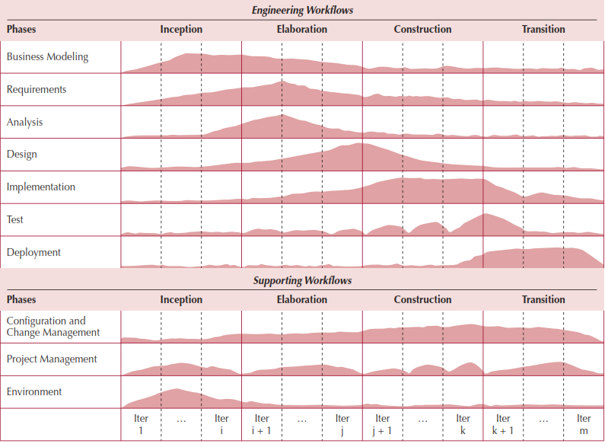
The Unified Process

Slide 37
Unified Process Phases
Inception
Feasibility analyses performed
Workflows vary but focus is on business modeling & requirements gathering
Elaboration
Heavy focus on analysis & design
Other workflows may be included
Construction: Focus on programming (implementation)
Transition--Focus on testing & deployment

Slide 38
Engineering Workflows
Business modeling
Requirements
Analysis
Design
Implementation
Testing
Deployment

Slide 39
Supporting Workflows
Project management
Configuration and change management
Environment
Operations and support*
Infrastructure management*
* Part of the enhanced unified process

Slide 40
Extensions to the Unified Process
The Unified Process does not include:
Staffing
Budgeting
Contract management
Maintenance
Operations
Support
Cross- or inter-project issues

Slide 41
Extensions to the Unified Process (cont.)
Add a Production Phase to address issues after the product has been deployed
New Workflows:
Operations & Support
Infrastructure management
Modifications to existing workflows:
Test workflow
Deployment workflow
Environment workflow
Project Management workflow
Configuration & change management workflow

Slide 42
Unified Modeling Language
Provides a common vocabulary of object-oriented terms and diagramming techniques rich enough to model any systems development project from analysis through implementation
Version 2.5 has 15 diagrams in 2 major groups:
Structure diagrams
Behavior diagrams

Slide 43
UML Structure Diagrams
Represent the data and static relationships in an information system
Class
Object
Package
Deployment
Component
Composite structure

Slide 44
UML Behavior Diagrams
Depict the dynamic relationships among the instances or objects that represent the business information system
Activity
Sequence
Communication
Interaction overview
Timing
Behavior state machine
Protocol state machine,
Use-case diagrams

Slide 45
Summary
All systems development projects follow essentially the same process, called the system development life cycle (SDLC)
System development methodologies are formalized approaches to implementing SDLCs
The systems analyst needs a variety of skills and plays a number of different roles
Object-oriented systems differ from traditional systems

Slide 46
Summary
Object-Oriented Systems Analysis and Design (OOSAD) uses a use-case-driven, architecture-centric, iterative, and incremental information systems development approach
The Unified Process is a two-dimensional systems development process described with a set of phases and workflows
The Unified Modeling Language, or UML, is a standard set of diagramming techniques

Slide 47
Questions?

